Slide 1

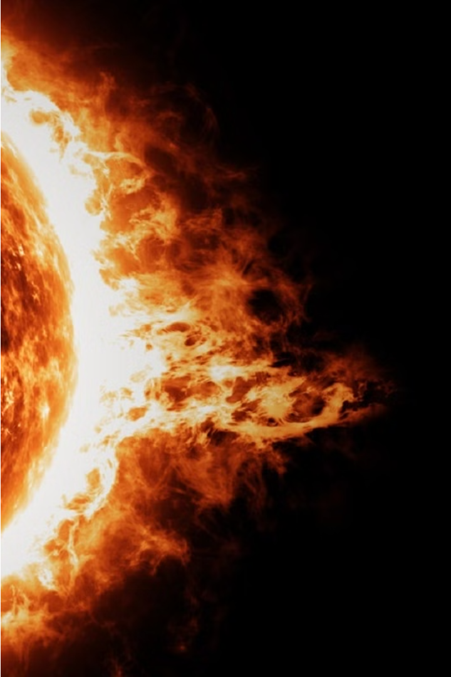
Machine Learning Model to Estimate the Damage on the Economy due to Solar Storm over a Specific Region
by
Mili Chowdhury
Pratishruti Sahoo
Subhadeep Dey

Slide 2
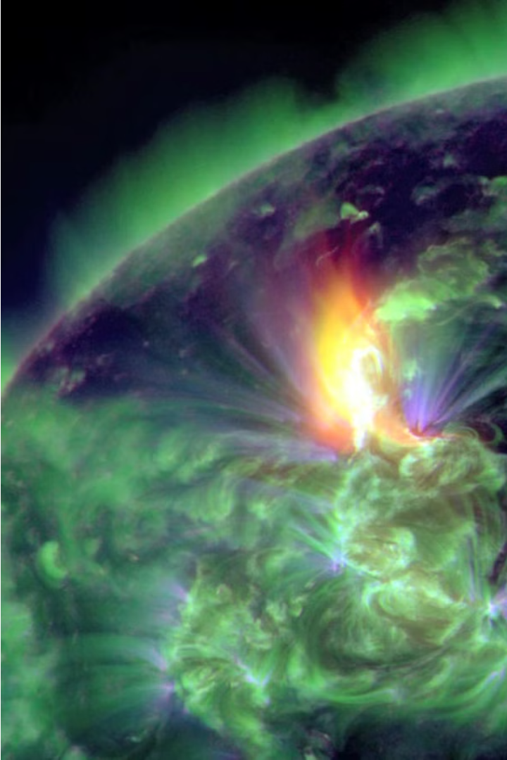
Introduction
Solar storms can have devastating effects on modern infrastructure and pose serious risks to our interconnected world.
This presentation will explore the use of machine learning models to accurately assess and mitigate the potential damage from solar activity in a specific region on the Earth and finally their effects in the economy.

Slide 3
Uniqueness of the Model
Estimation of the Damage
1
This model forecasts the damage by taking into account how susceptible the infrastructure is to potential solar storms.
2
Geospatial Adaptability
In addition, it forecasts the monetary loss for a given area based on an assessment of the potential solar storm's damage.
Proactive Approach
3
These two factors allow the model to provide information about the preventative steps that should be taken in case of a solar storm over that area.

Slide 4
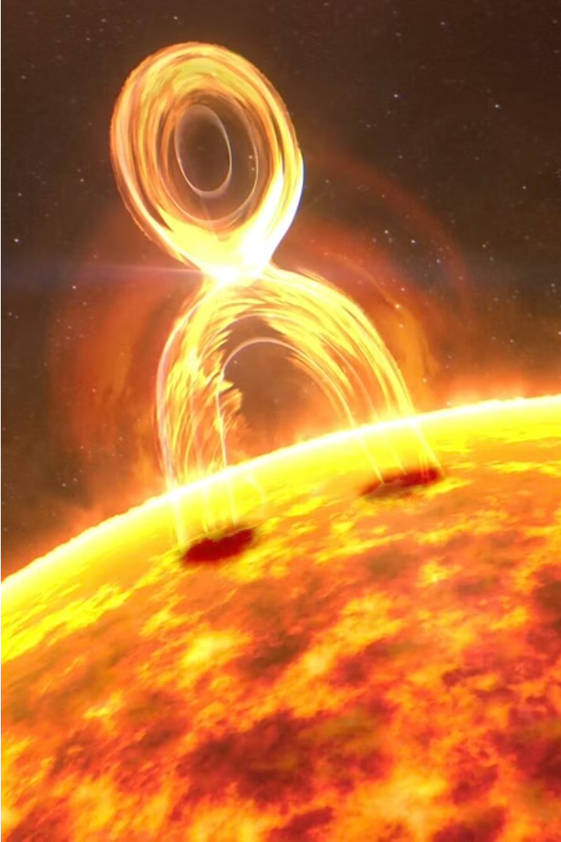
Effects of Solar Storm on the Earth
1
Electrical Grid Disruptions
Solar storms can induce powerful currents in power lines, causing widespread blackouts and damage to electrical infrastructure.
2
Satellite & Communication Disruptions
Solar radiation can interfere with satellite operations, GPS signals, and communication networks, hampering modern connectivity.
3
Airline & Navigation Disruptions
Increased radiation during solar storms can force airlines to reroute flights, leading to delays and cancellations due to interruption on RADARs. Navigation systems can also be affected.

Slide 5
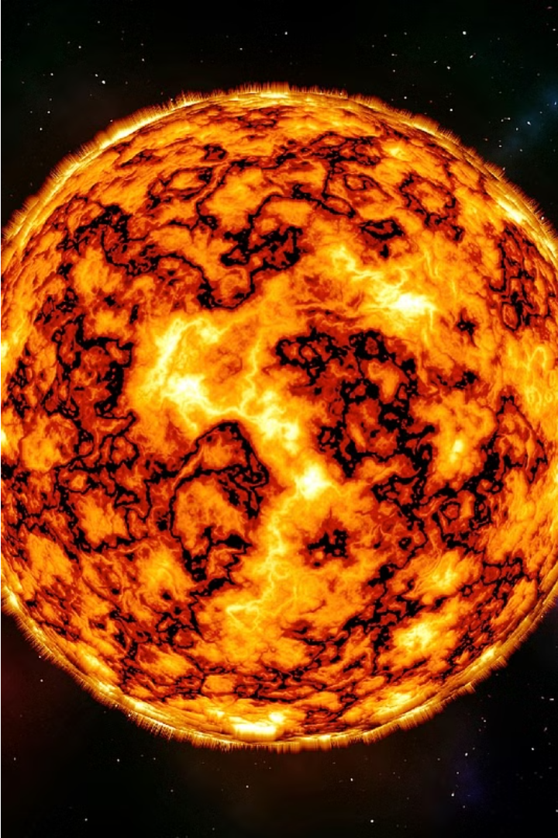
Previous Rampages of the Sun
The Carrington Event (September 1859)
The Bastille Day Solar Storm (July 2000)
The Halloween Solar Storms (Oct 2003)

Slide 6
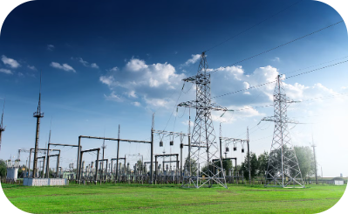
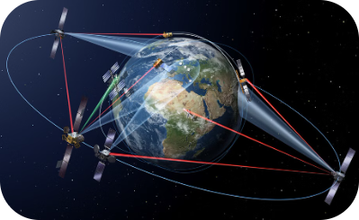
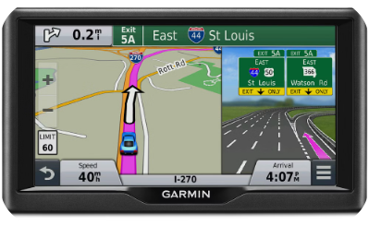
Practical Applications of This Model
Power Grid Resilience
Satellite Communications
GPS and Navigation
Machine learning models can help to predict and can try mitigate the impact of solar storms on power grid infrastructure, enabling proactive risk management and faster restoration of services.
By forecasting the effects of solar storms on GPS and navigation systems, these ML models can support reliable transportation, aviation, and location-based services during extreme space weather events.
These models can also assess the vulnerability of satellite communications networks to solar storm disruptions, informing system design and backup planning for mission-critical applications.

Slide 7
Challenges in Building the Model
Paucity of Detailed Historical Records
Non-Centralized Data
The different helioscopic data are recorded by different observatories (both on the Earth and satellites).
Numerous incidents that occurred throughout history are not documented.
Geospatial & Demographic Data
Integrating Data regarding Disaster-prone Infrastructures
Details about the population and asset locations in a particular area that the solar storm is expected to affect.
Detailed information on the power grid infrastructure, including the locations of substations and transmission lines, along with the data vis-a-vis the damage on the satellites, telecommunication networks etc.

Slide 8
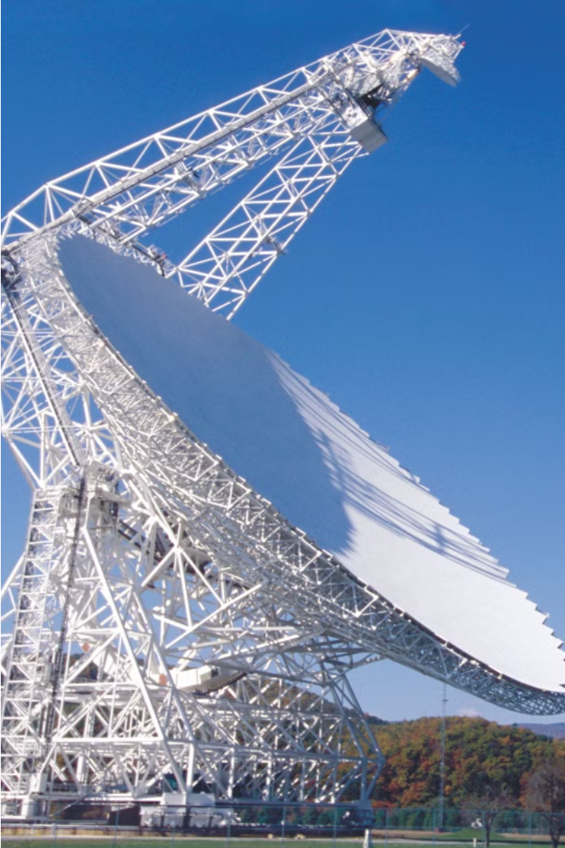
Data Collection and Preprocessing
Gather historical data on solar storms and their impact on power grids, communication systems, and satellites in the target region.
Collect detailed geospatial data such as population density, and asset locations, in order to model the vulnerability of the region.
Preprocess the data to handle missing values, outliers, and inconsistencies, ensuring data quality and integrity for the machine learning model.

Slide 9
Rationale behind using ML over Statistical Analysis
Nonlinearity Modeling
1
The relationship between geomagnetic disturbance and solar activity is nonlinear. Additionally, it is dynamic and changes rapidly over time. ML is superior because it also requires the integration of data from many sources.
2
Handling Uncertainty
Machine learning models can handle large and diverse datasets and can adopt over time. Models like semi-supervised and reinforcement machine learning can work with sparse data and provide accurate predictions.
Scalability and Adaptability
3
Such a model like ours involve complete high dimensional data and non-linear relationships. Our data also can face multi-collinearity and autocorrelation which a machine learning model can handle better than a statistical model.
4
Compilation of Data
Such a model involves complex data from various resources such as Solar absorptions, Geomagnetic measurements, and historical solar storm data. Such variables may not be easily discernible through tradition statistical methods.

Slide 10
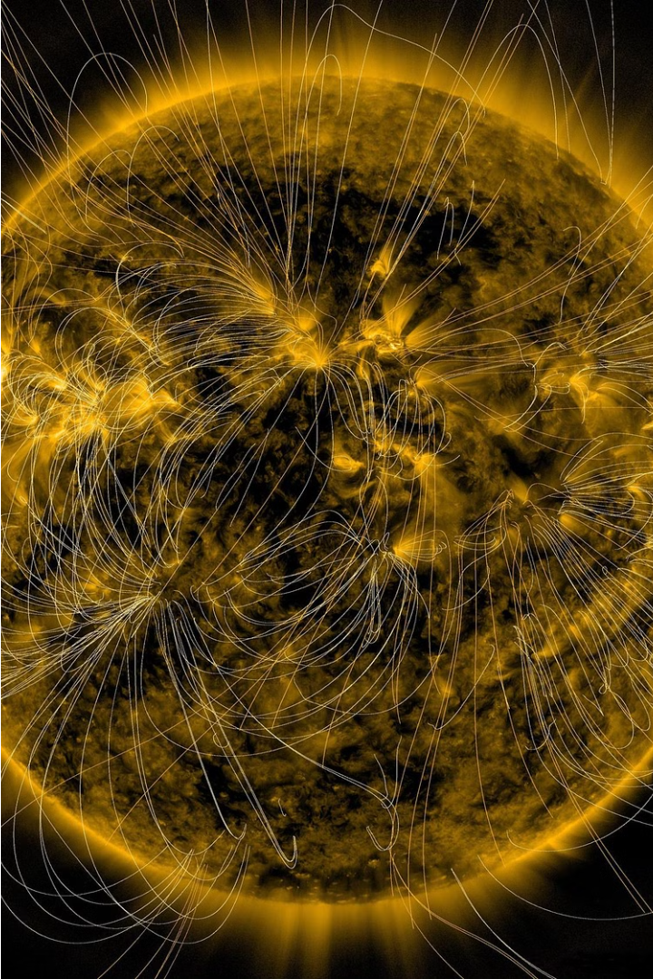
Feature Engineering and Selection
1
Data Exploration
Conduct a thorough analysis of the available data, including statistical summaries, visualizations, and identification of key variables that may influence solar storm damage.
2
Feature Generation
By integrating or modifying the raw data, one can produce new characteristics like classifying the damages into distinct groups according to the damages within different sectors.
3
Feature Selection
Use advanced techniques like correlation analysis, recursive feature elimination to identify the most informative and predictive features for the damage estimation model.

Slide 11



Damage Estimation Methodology
Data Modeling
1
Develop predictive models to estimate damage based on historical data and simulations.
Vulnerability Assessment
2
Analyze infrastructure susceptibility and exposure to solar storm impacts.
Risk Quantification
3
Quantify potential economic losses and disruptions.

Slide 12
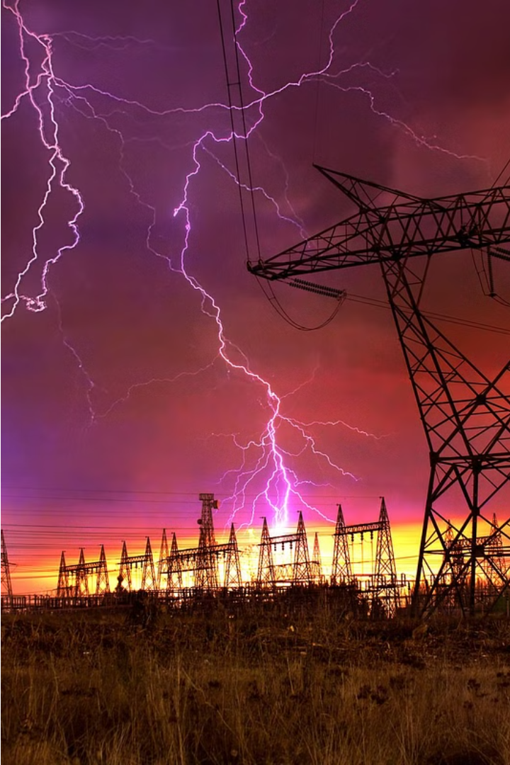
Damage Estimation Methodology
The damage estimation methodology involves a multifaceted approach.
First, developing data-driven predictive models to estimate the extent of damage based on historical observations with the help of regression tree algorithm.
Second, conducting a detailed vulnerability assessment to understand the susceptibility and exposure of critical infrastructure within the region, and quantifying the potential economic losses, service disruptions that could result from a severe solar storm.
Finally, in order to adjust the inflation rate, a base year will be taken and as per the present economic conditions the predicted value of economic loss will be determined.

Slide 13
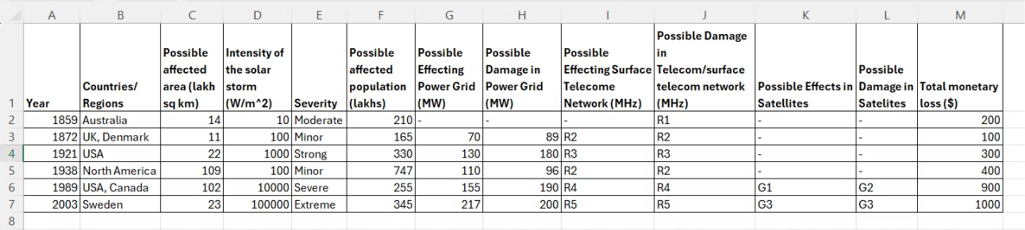
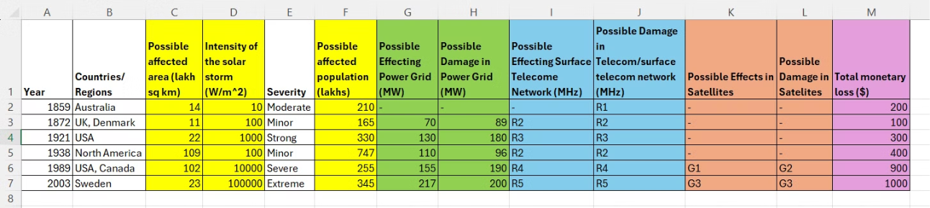
Dummy Dataset
Raw Data
Dataset with Selected Features

Slide 14

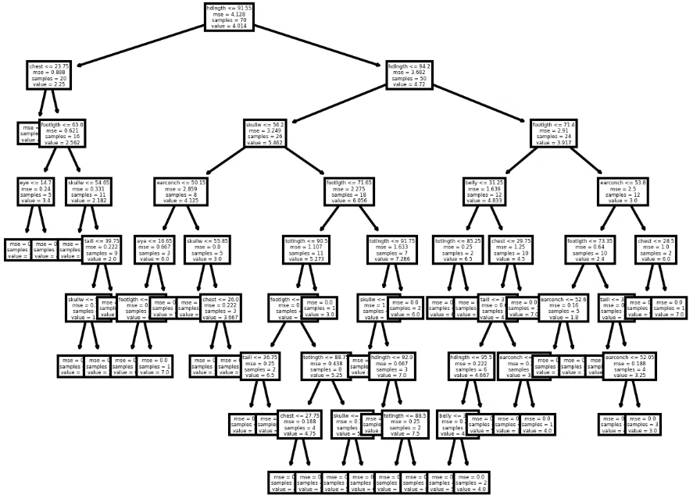
Model Architecture and Training
The machine learning model for solar storm damage estimation utilizes the regression tree algorithm. This model can capture the relationships between various input features and the predicted damage levels.
The model is trained on a dataset of historical solar storm events and observed damage patterns.

Slide 15
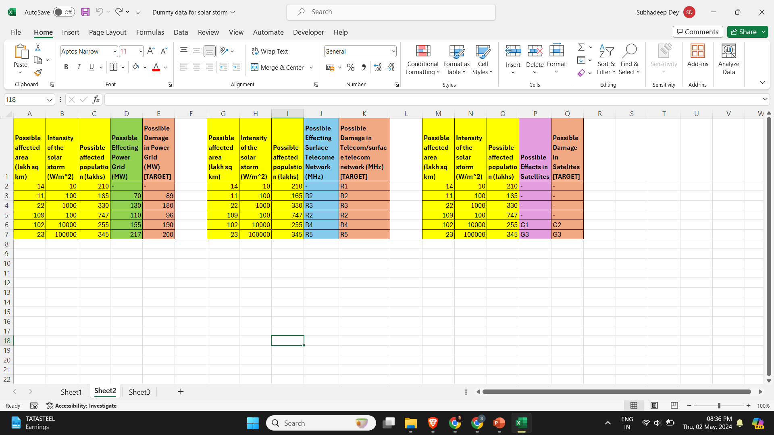
First Three Regression Trees
Regression Tree 1
For estimating the damage on the power grid resilience
Regression Tree 2
For estimating the damage on the telecom network on the Earth’s surface
Regression Tree 3
For estimating the damage on the space satellite network

Slide 16

Final Regression Tree
Final Regression Tree
For estimating the total monetary loss

Slide 17
Model Evaluation and Validation
Evaluation Metrics
Cross-Validation
Holdout Testing
Sensitivity Analysis
Carefully select appropriate evaluation metrics to assess the model's performance, such as accuracy and root mean squared error (RMSE) for regression tasks. It should also be noted that using RMSLE will be preferable if the predicted values’ range is approaching a large value.
(N.B.: While calculating the accuracy, the predicted value will be considered as a correct value if it is within the range of 5% on both sides)
Employ robust cross-validation techniques to ensure the model's generalization capability and avoid overfitting, such as k-fold cross-validation.
Set aside a dedicated testing dataset to evaluate the model's performance on unseen data and gain insights into its real-world applicability.
Conduct sensitivity analysis to understand the model's behavior and identify the most influential features, helping to refine the model and feature engineering process.

Slide 18
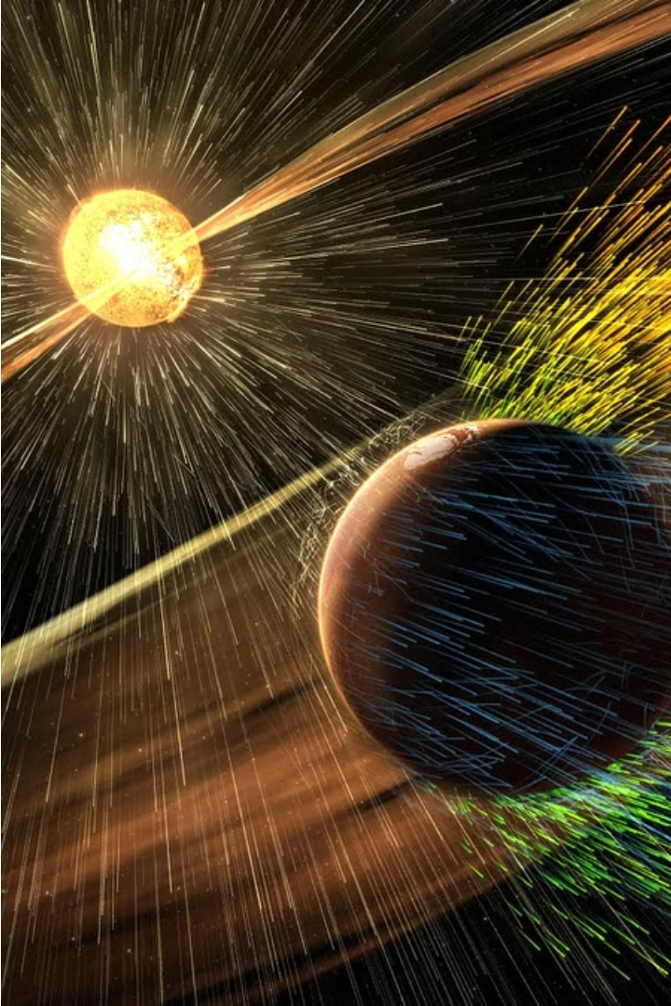



Sensitivity Analysis and Uncertainty Quantification
Sensitivity Analysis
Assess the impact of input parameter variations on model outputs. Identify the most influential factors driving solar storm damage estimates.
Uncertainty Quantification
Characterize the uncertainty in the input data, model parameters, and assumptions. Propagate these uncertainties through the model to derive probabilistic damage estimates.
Scenario Analysis
Simulate multiple plausible solar storm scenarios to understand the range of possible outcomes and their likelihood. Inform risk-based decision making.

Slide 19
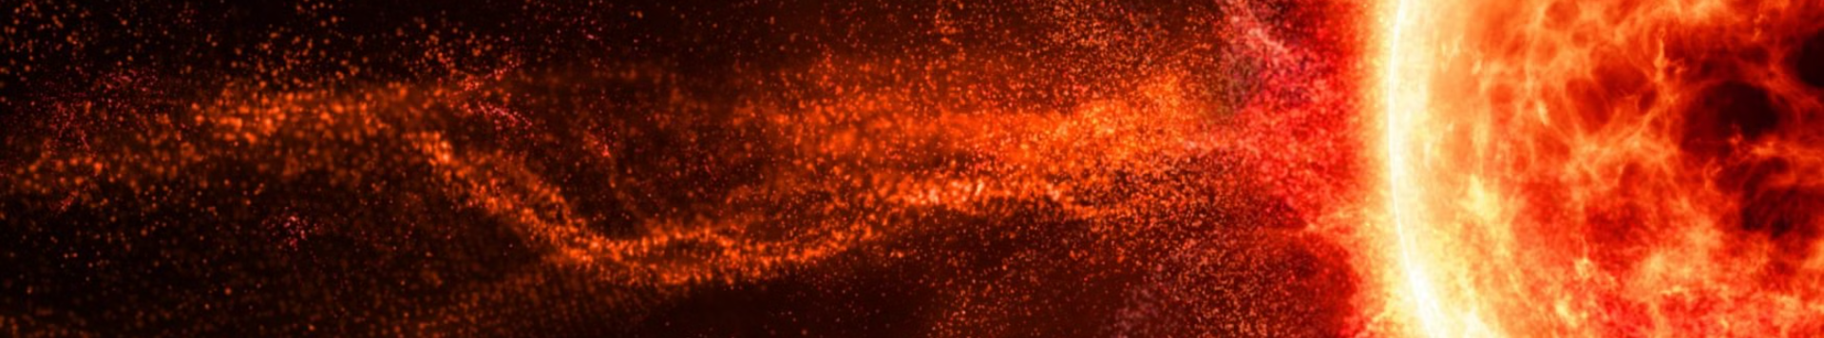



Conclusions
Key Takeaways
Global Implications
Outlook
The machine learning model developed can accurately estimate the economic damage caused by solar storms, enabling proactive risk mitigation strategies.
Solar storms pose a significant threat to modern infrastructure, with potential for widespread disruption. This model can help inform global preparedness efforts.
Continued research and refinement of the model can enhance its accuracy and applicability, strengthening our resilience to the impacts of solar storms.

Slide 20
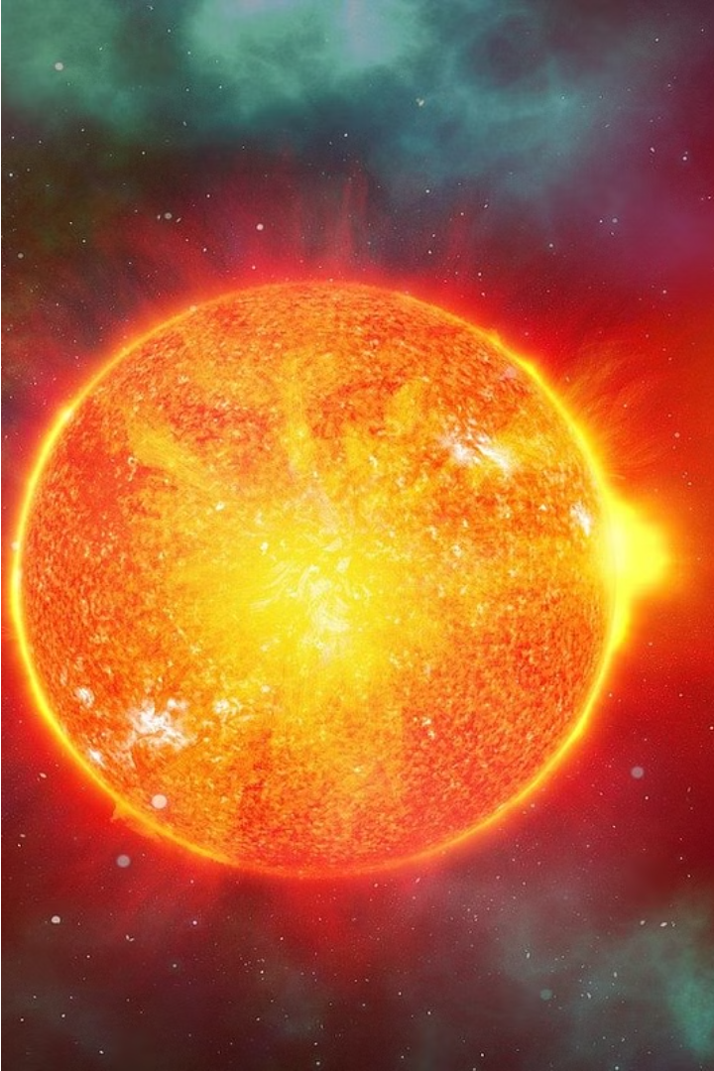
Scope of Improvement
1
Closer to Reality
By adding more characteristics, such as, weather data, geomagnetic data etc., we can get the model closer to reality and better estimation, but in such a way that the model complexity does not compromise the performance.
2
Expanding Geographical Scope
Future research should explore expanding the model to other regions prone to solar storm activity, allowing for more comprehensive risk assessment and preparedness planning across the globe.
3
Integrating Real-time Data
Incorporating live satellite monitoring and forecasting data could further enhance the model's accuracy and enable near-real-time damage estimation, facilitating more timely emergency response and mitigation strategies.
4
Exploring AI-Powered Simulations
Advancing the model to leverage cutting-edge AI and simulation techniques could unlock even more sophisticated scenario analysis and predictive capabilities, empowering decision-makers to proactively address the challenges posed by solar storms.

Slide 21
Thank You

